Slide 1


Machine Learning for Downtime Prediction
STAT606 Practical Assignment
Binary Classification: Maintenance Requirement Prediction
By Yanga Ndamase (226029024) & Mawanda Mbaza (226024595

Slide 2


Brief introduction to the data and problem
Dataset
We are using the iportal_downtimes dataset from manufacturing operations.
The dataset contains machine downtime events (features) from PLC in roborts such as:
downtime duration
fault duration
plant
department
area
downtime type
failure reason
machine messages
timestamps
Each row represents a machine downtime incident.
This will help:
reduce production downtime
prioritize maintenance teams
improve operational efficiency
Business Problem
The objective is to predict whether machine downtime/failures require maintenance using EMEA plants historical downtime logs.
Goal: Reduce unplanned downtime through early identification of maintenance needs.
Binary classification problem: MaintenanceRequired (0/1)
Target Variable:
MaintenanceRequired
Mantainance Required | Target
Yes | 1
No | 0

Slide 3
Data Understanding, Preparation & Feature Engineering
Duplicate removal: unique(df) used to eliminate repeated downtime records.
Missing numeric values: imputed using median (robust to outliers).
Missing categorical values: replaced with 'Unknown' category.
Fixed NaN and infinite values before modelling our data in H2O environment
High-cardinality identifiers removed (e.g., DowntimeId) to reduce noise.
Leakage removed (DowntimeType), Class order forced (levels = c("0","1")) ,Numeric conversion + median imputation were also used.
Feature Engineering (Purpose: Improve model ability to capture operational behaviour patterns)
Target creation: based on median downtime threshold + failure keywords.
New features: Hour extracted from timestamp, DayOfWeek derived from date.
EmergencyFlag created using keyword detection (emergency, critical, urgent).

Slide 4
4. Machine Learning Models
Four classification techniques were applied:
- Decision Tree (interpretable rule-based model)
- Logistic Regression (linear baseline model)
- Naive Bayes (probabilistic independence model)

Slide 5
Model Evaluation & Results
- Used 70:30 split ensuring class representation.
Evaluation metric: AUC (Area Under Curve) - We use AUC instead of F1 because : - downtime data is often imbalanced
Findings:
The Decision Tree achieved the highest AUC - demonstrating the strongest predictive performance on the held‑out test set.
Logistic Regression showed lower performance, as its linear structure limited its ability to capture non‑linear and threshold‑based patterns in maintenance behaviour.
Naïve Bayes performed poorest - likely due to violations of the conditional independence assumption after data cleaning and leakage removal.

Slide 6
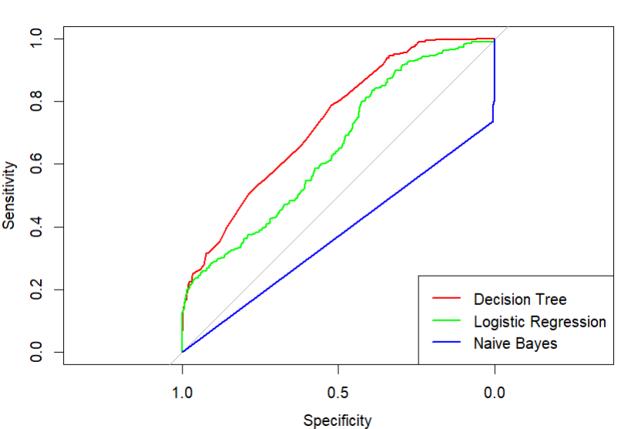
Key Drivers & Conclusion
Top predictive features (Decision Tree):
- Downtime Duration
- Fault Duration
- Emergency Flag
- Downtime Type
- Hour of occurrence
Conclusion:
ROC Curve Insight
Decision Tree shows the strongest ROC performance.
High sensitivity achieved with better separation of classes.
Logistic Regression offers moderate discrimination.
Naïve Bayes performs close to random guessing.
Notes:
Based on AUC evaluated on a held‑out test set, the
Decision Tree achieved the best predictive performance (AUC ≈ 0.7322), indicating the strongest overall discriminative ability.
Logistic Regression showed moderate performance, constrained by its linear modelling assumptions. In contrast,
Naïve Bayes exhibited weak generalisation after data cleaning and leakage removal, suggesting that its conditional independence assumption was not well suited to the final feature set.
Consequently, feature importance and key drivers of maintenance were interpreted primarily using the Decision Tree and supported by Logistic Regression. The results further demonstrate that feature engineering substantially improved predictive power, with downtime severity, time‑based patterns, and operational context emerging as the primary drivers of maintenance requirements.

